Slide 1
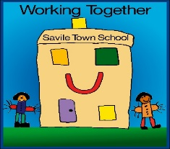
RSHE - Parent Consultation - February 2021
Information for parents and carers of Savile Town Infant & Nursery School
Aims
To share the facts about the new Government guidance and content.
To address any misconceptions.
To give an overview of what and how PSHE/RHE is taught at Savile Town Infant and Nursery School.
To understand why PSHE/RHE matters.

Slide 2
School Vision-Savile Town Infant and Nursery School
At our school we celebrate faith, diversity and provide a safe environment where our children are happy to learn. We are kind, caring and respectful to others. We aim to inspire future generations of our school and community to become lifelong learners.

Slide 3
What does it mean?
DfE
Department for Education – GOV.UK
Personal, social, health and economic education (the umbrella term for the curriculum subject that includes RSHE)
PSHE ed
RSHE
Relationships education, relationships and sex education and health education (the name of the new statutory guidance)
RHE
Relationships and Health Education
RSE
Relationships and Sex Education (not compulsory in Primary schools)
SMSC
Social, moral, spiritual and cultural (education)

Slide 4
Why is RSHE taught in schools?
The intent or purpose of RSHE in schools is to prepare children for the next stage of life/school journey
Personal, social, health and economic (PSHE) education is a subject through which pupils develop the knowledge, skills and attributes they need to manage their lives, now and in the future.
This knowledge, and these skills and attributes, will help pupils to:
be healthy
stay safe and help others to be safe
become responsible and caring citizens
be prepared for adult life and work in modern Britain

Slide 5
Why do RSHE and PSHE matter?
Improves health and wellbeing (individuals and society)
Links with safeguarding (pupil safety)
There is a link between high quality PSHE education and improved attainment
It contributes to the health of the nation
Helps foster respect for difference and promote inclusion
Increases independence and prepare pupils for future roles as parents, employees and leaders
Underpins future employability (so called ‘soft’ skills)
Helps prepare pupils to know and understand the law in the UK

Slide 6
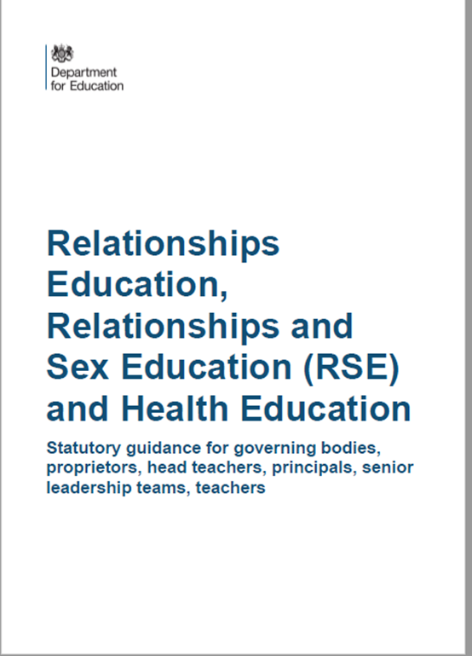
The statutory Guidance
Primary schools must provide Relationships Education and Health Education as part of the basic curriculum
from September 2020
“The focus in primary school should be on teaching the fundamental building blocks and characteristics of positive relationships, with particular reference to friendships, family relationships, and relationships with other children and with adults.”
RHE or RSE?
The Relationships Education, RSE, and Health Education (England) Regulations 2019 have made Relationships Education compulsory in all primary schools.
Sex education is not compulsory in primary schools and the content set out in this guidance therefore focuses on Relationships Education.
Basic First Aid
Pupils should know:
how to make a clear and efficient call to emergency services if necessary
concepts of basic first-aid, for example dealing with common injuries, including head injuries
“Physical health and mental wellbeing are interlinked, and it is important that pupils understand that good physical health contributes to good mental wellbeing, and vice versa.”
GOV.UK

Slide 7
By the end of primary school (KS2) pupils will be taught content on;
Relationship Education
Families and people who care for me
Caring friendships
Respectful friendships
Online relationships
Being safe
Health Education
Mental wellbeing
Internet safety and harms
Physical health and fitness
Healthy eating
Facts and risks associated with harmful substances
Health and prevention
Basic first aid
Changing body
You can find further detail by searching ‘relationship and health education’ on GOV.UK

Slide 8
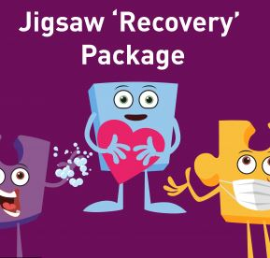
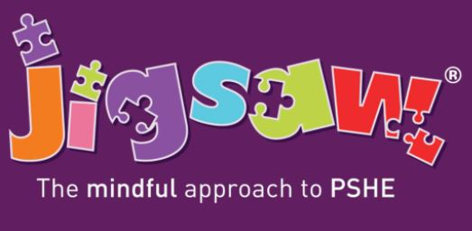
PSHE RHE at Savile Town Infant School
During the current pandemic Jigsaw has offered recovery
lessons to help children make sense of and talk about
their Covid 19 and Lockdown experiences. Mental health and wellbeing are prioritised as we prepare to return once again.
At Savile Town we have been teaching to the statutory requirements through a programme of study called Jigsaw (The Mindful Approach to PSHE). Jigsaw fulfils the DfE requirements and allows for a whole school approach in an age approach
and familiar way.
www.jigsawpshe.com

Slide 9
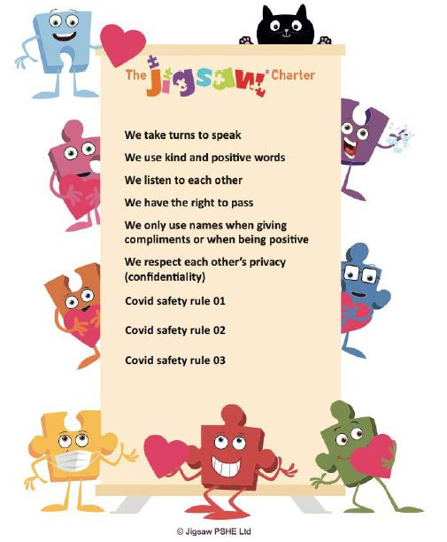
On returning to school once again after Lockdown, each class will create a new Jigsaw charter to reflect our every changing ‘new normal’ and Covid Safety restrictions.
What a Jigsaw Lesson looks like;
Before we start a PSHE lesson we read the Jigsaw Charter to remind ourselves about what is expected of us and what we can expect from others.
In every lesson children have the right to pass (not speak) should they choose.

Slide 10
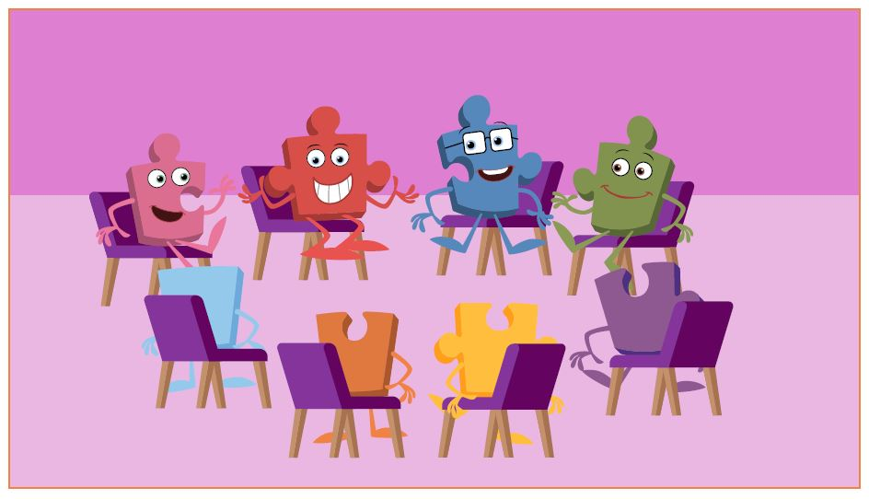
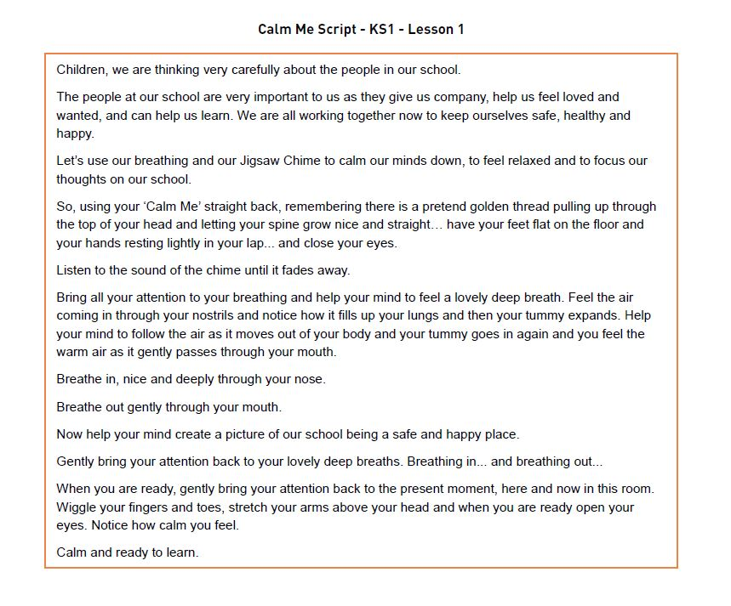
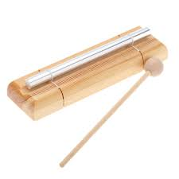
What a Jigsaw Lesson looks like;
Calm Me
Is the part of the lesson where we practise mindfulness; slowing down our minds and concentrating on our breathing by quietly listening to a chime and opening our eyes when we can no longer hear it.
With regular practise the children become familiar and often really enjoy this part of the lesson.
Connect Us
This is the part of the lesson where we play a team or circle game such as ‘Pass the Smile’ around the circle (or class).
The idea is to help bond, relax and connect our class community. Feeling happy, comfortable and respected within our classrooms is important to everyone at Savile Town.

Slide 11
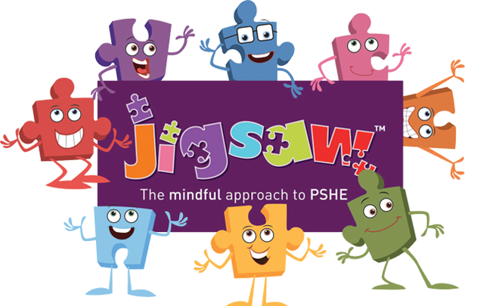
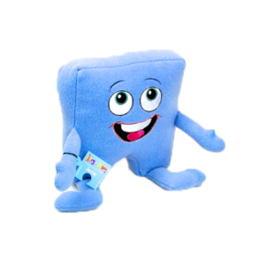
What a Jigsaw Lesson looks like;
Let Me Learn
In this part of the lesson we might role play an idea, talk about new information, read a story, draw pictures or complete an activity.
6 Jigsaw Pieces
Being Me in My World
Celebrating Differences
Dreams & Goals
Healthy Me
Relationships
Changing Me
These 6 pieces are repeated from Early Years to Year 2 meaning the children are familiar with topics, ideas and words. Increasing their learning each year in an age appropriate way.
Help Me Reflect
Here we remind ourselves of the topic or learning point for the lesson. We might recap new words or ideas to clarify understanding.
Tell Me or Show Me
This part of the session allows for time to talk, reflect or share about the lesson topic. We use puppets and approach topics in age appropriate ways, discussing what feelings, words or ideas such as happy, sad, respect, trust, healthy mean.

Slide 12
Parents & Carers Views
This is where we invite you our parents and carers, the first teachers of the children who attend Savile Town I & N, to consult with us by answering this simple online survey;
https://www.surveymonkey.co.uk/r/LHV2QDB
Thank you for taking the time to read this PowerPoint and answer the questions as we begin our RHE Consultation Period.
Thankyou and Stay Safe
☺

